Slide 1
Predicting Box Office Success through Indicator analysis
TEAM 1ㅣ20190196 김태형
20190361 안선호
20190573 전재완

Slide 2
INDEX
01
Project overview
02
Related Works
03
Data sets
04
Data Analysis
05
Conclusion

Slide 3

01
Project overview

Slide 4





01
Objectives
Project Overview
Ratings
Revenue
우리 연구의 목적은 영화의 평점과 수익에 영향을 주는 요소를 찾고, 각 요소별로 평점과 수익에 어떻게 영향을 주는지 그 상관관계를 찾는 데에 있다.

Slide 5
01
Objectives
Project Overview
Budget – Revenue
Genre – Earnings rate
Budget – Ratings
그리고 영화의 여러 관계 중, Budget – Revenue, Genre – Earnings rate, Budget – Ratings의 관계를 중점적으로 분석할 예정이다. 여기서 Earnings rate은 뒤에서 설명하겠지만, 우리가 새롭게 만든 지표로 수익률을 의미하며, Revenue/Budget으로 구한다.

Slide 6






01
Problem Statement
Project Overview
21th film industry
20th film industry
우리가 이 주제를 선정한 이유에 대해 말하겠다. By the 21st century, the film industry had developed significantly. Despite the decline in movie theater sales due to COVID-19, people watch various movies using movie platforms such as ‘Netflix’ and ‘Watcha’. The film industry, which is receiving great attention, continues to change and develop. Genres that were not previously spotlighted suddenly become popular (e.g. Avengers of Marvel Studio), and new genres such as SF and fantasy are made. Also, film companies are willing to produce good films at an enormous budget (Avengers: Endgame's production cost is a whopping $1.56 billion).
It is important to know which movies are popular in this fashionable situation. Therefore, we would like to look at various indicators related to movies to find out what kind of movies are popular.

Slide 7
02
Related Works

Slide 8
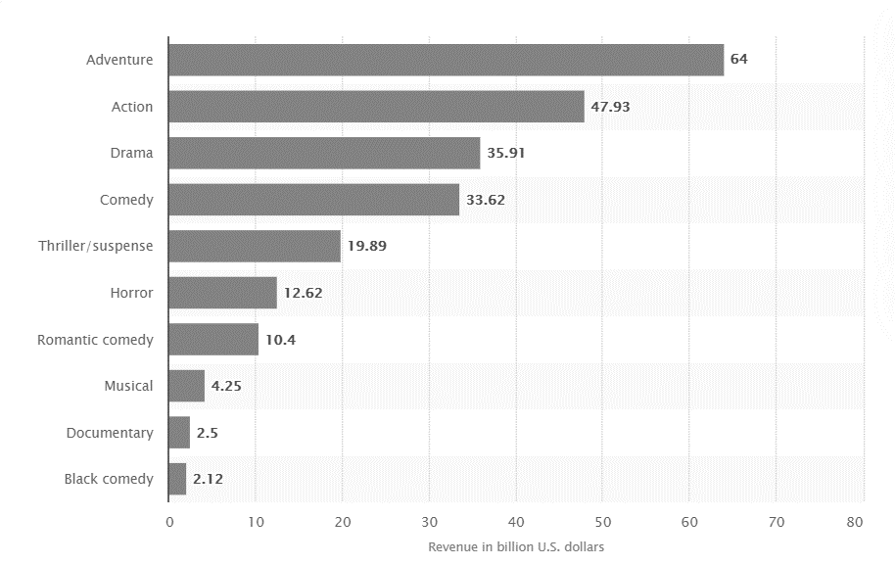
02
“Movie genres ranked by total box office revenue in North America 1995-2021”
Related Works
Genre – Total Revenue
Upper data indicates genre - total revenue in North America from 1995 to 2021. Following this data, “Adventure” movies earn the most, more than 60 billion U.S. dollars while “Black comedy” movies earn 2.12 billion U.S. dollars. (우리가 할 연구와는 어떻게 다른 지 설명 필요)

Slide 9
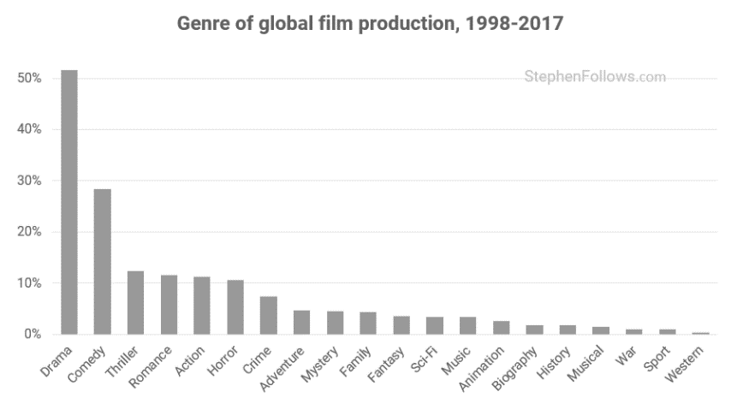
02
“Genre trends in global film production”
Related Works
Another data indicates genre trends of global film production between 1998 to 2017. According to this data, we can find the most popular genre, the genre which has strong growth momentum, the genre which has weak growth momentum. (마찬가지로 우리가 할 연구에 어떤 관련이 있는지 설명 필요)

Slide 10
03
Data Sets

Slide 11
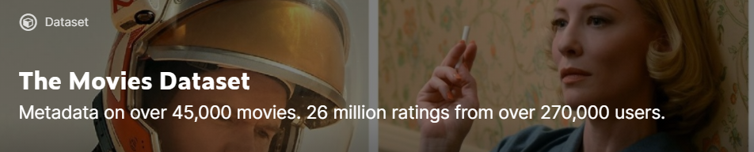

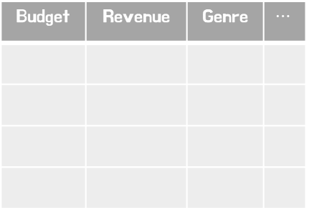
03
Raw Data
Data Sets
Main Dataset
movies_metadata.csv
ratings.csv
Budget | Revenue | Genre | $$⋯$$
userId | movieId | rating | timestamp
우리가 사용한 데이터는 kaggle에서 가져왔다. These files contain metadata for all 45,000 movies listed in the Full MovieLens Dataset. The dataset consists of movies released on or before July 2017. (만약 최신 자료도 찾으면 이 슬라이드의 내용 수정 필요)
이 중 movies_metadata 파일과 ratings 파일을 사용했다. Movies_metadata는 the main Movies Metadata file which contains almost overall data of each single movie. It contains information on 45,000 movies featured in the Full MovieLens dataset(The Full MovieLens Dataset consists of 26 million ratings and 750,000 tag applications from 270,000 users on all the 45,000 movies.). Features include posters, backdrops, budget, revenue, release dates, languages, production countries and companies. 그리고 ratings 파일은 has files containing 26 million ratings from 270,000 users for all 45,000 movies. Ratings are on a scale of 1-5 and have been obtained from the official GroupLens website.

Slide 12
03
Pre-processing for analysis
Data Sets

Slide 13
04
Data Analysis

Slide 14
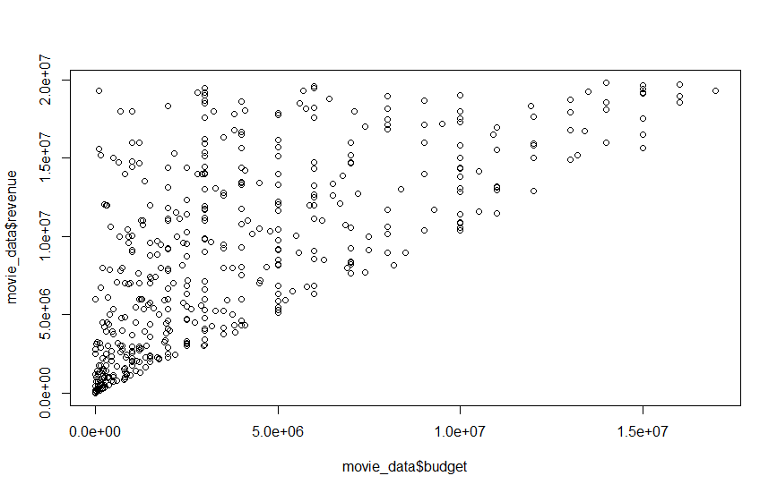
04
Budget - Revenue
Data Analysis
Budget – Revenue Relationship
1. Most movies are located in left-down locations.
2.No significant relationship between budget and revenue, where the earnings ratio is big enough.

Slide 15
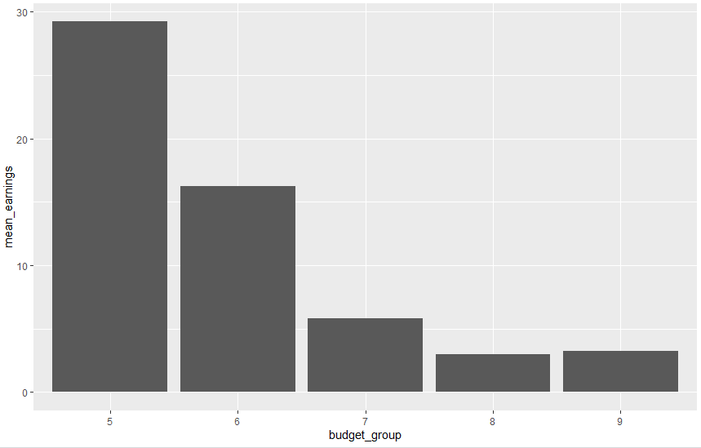
04
Budget - Revenue
Data Analysis
Budget(log scale) – Mean Earnings rate Relationship
Less budget, More earning rate
More budget, Less earning rate

Slide 16
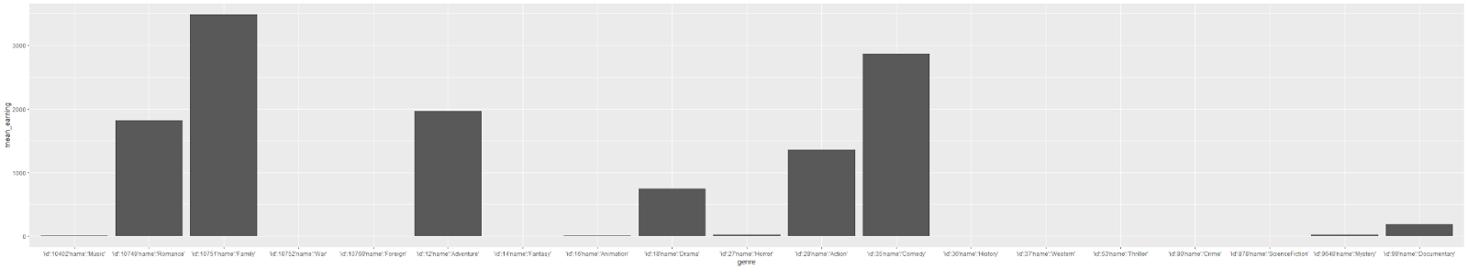
04
Genre - Earnings rate
Data Analysis
Genre - Earnings rate Relationship
romance
war
documentary
family
action
adventure
comedy
1. Family and Comedy genres are easy to make a success.
2. 이 히스토그램을 보면, 서부극이 family영화보다 더 earning ratio가 낮다. 이걸 단순히 family 영화가 더 earning이 높다 = 돈 벌기 쉽다로 연결시키는 것 보다 영화가 나왔던 시대의 물가 등을 고려해서 연결지으면 더 좋을 것 같다.
(서부극은 거의 한 시대에만 나왔고, 그때 당시에는 영화 산업이 지금과 같이 팽창하기 이전이었으므로)

Slide 17
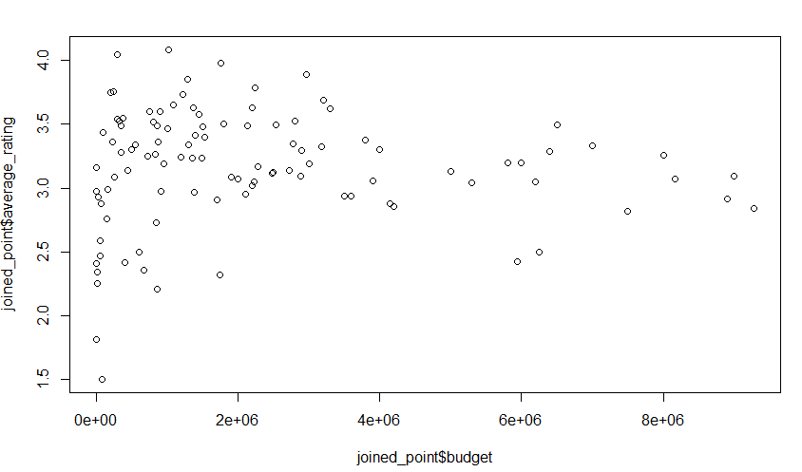
04
Budget - Ratings
Data Analysis
Budget – Ratings Relationship
거의 연관이 없음

Slide 18
05
Conclusion

Slide 19

05
[제목]
Conclusion
슬라이드에 어울리는 적절한 내용으로 채워주세요

